Slide 1
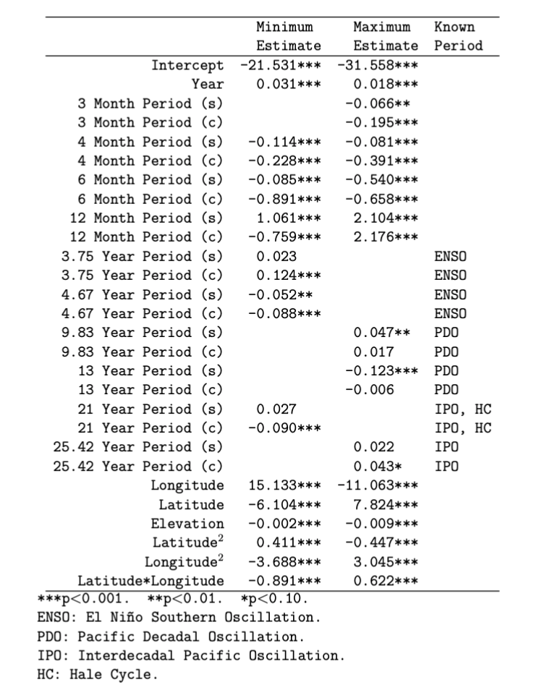
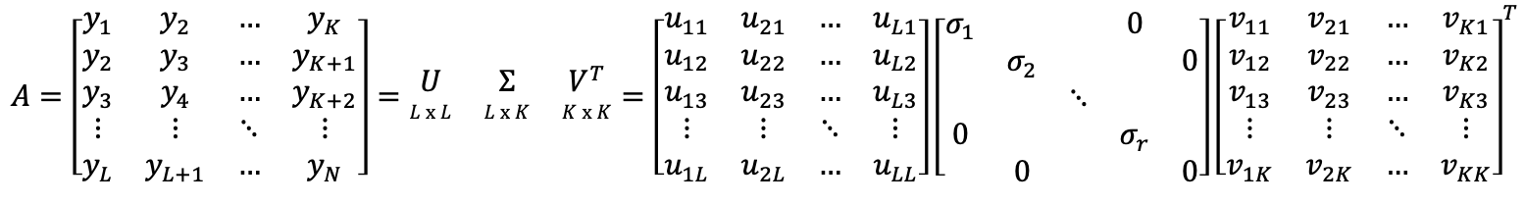
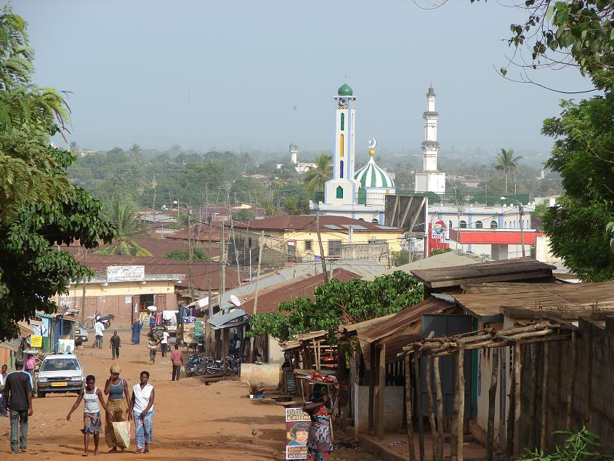
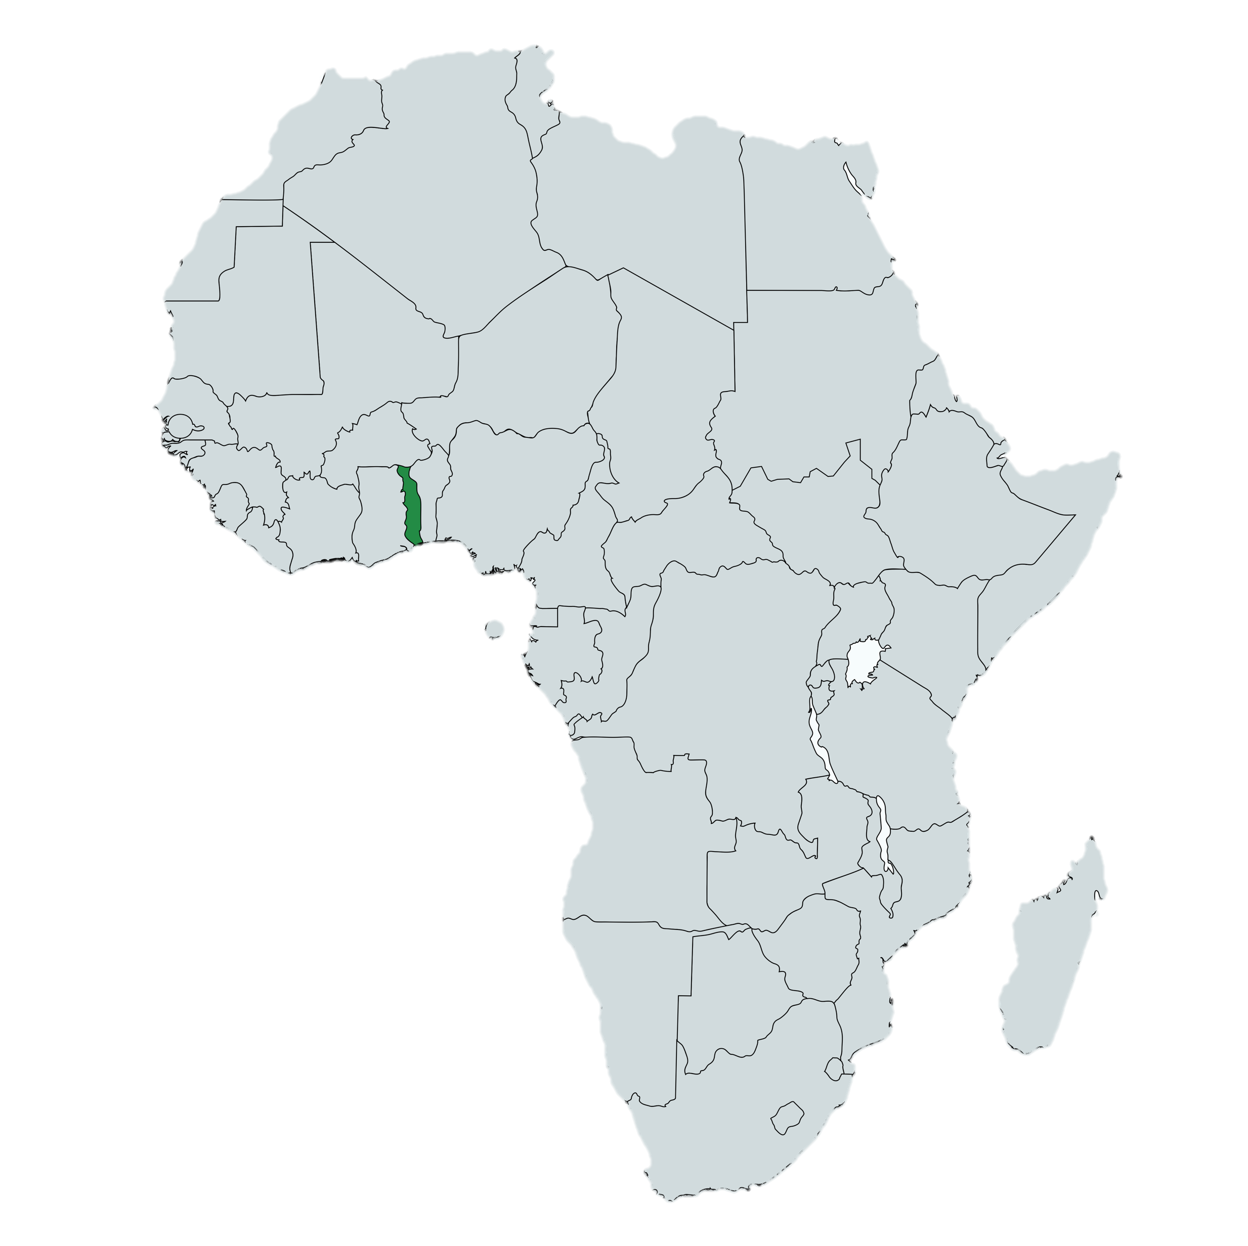
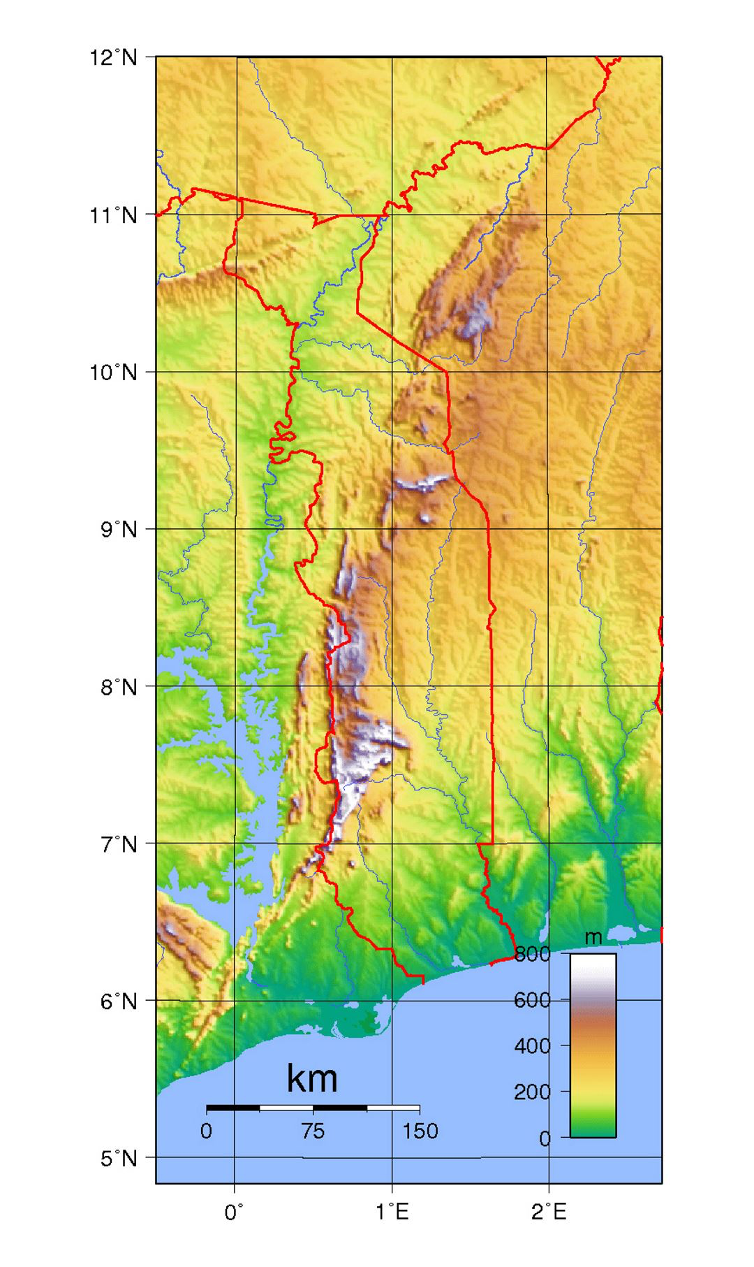

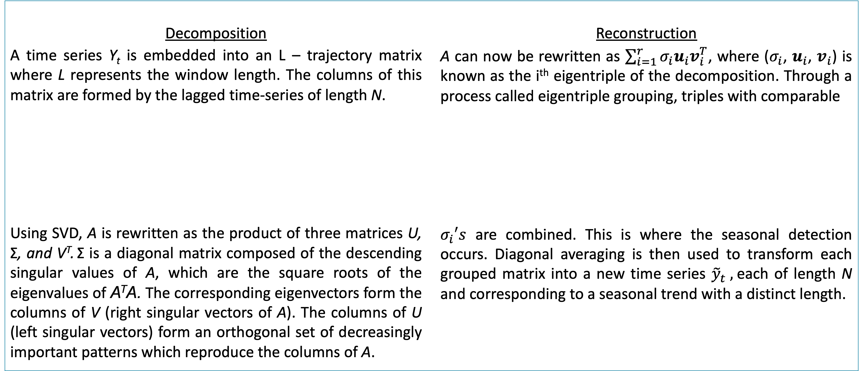
Togo, Africa: On track for over 3 °C of warming by 2100
Jacob Englert, Dr. Andrew Long
Northern Kentucky University Department of Mathematics and Statistics
Abstract
Singular Spectrum Analysis
Global Models
The West African nation of Togo has experienced rapidly rising temperatures over the course of the past six decades. Continually rising temperatures have disastrous implications for the agriculture, public health, and economy of Togo. We have constructed a regression model that captures the annual increase in temperature for all of Togo, based on monthly temperature data from ten different cities in the various geographic regions of Togo over the course of nearly 60 years. Singular Spectrum Analysis (SSA), an extension of the Singular Value Decomposition (SVD), is used to identify and thus incorporate seasonal fluctuations that align with known climatological phenomena into the model, permitting us to isolate the underlying increasing trend in temperature - a trend that suggests over 3 °C of continued warming from the start of the industrial age to the year 2100.
Decomposition
A time series Y_{t} is embedded into an L – trajectory matrix where L represents the window length. The columns of this matrix are formed by the lagged time-series of length N.
Using SVD, A is rewritten as the product of three matrices U, Σ, and V^{T}. Σ is a diagonal matrix composed of the descending singular values of A, which are the square roots of the eigenvalues of A^{T}A. The corresponding eigenvectors form the columns of V (right singular vectors of A). The columns of U (left singular vectors) form an orthogonal set of decreasingly important patterns which reproduce the columns of A.
Reconstruction
A can now be rewritten as $\sum_{i=1}^{r}{σ_{i}u_{i}v_{i}^{T}}$, where ($σ_{i}$, $u_{i}$, $v_{i}$) is known as the i^{th} eigentriple of the decomposition. Through a process called eigentriple grouping, triples with comparable
$σ_{i}′s$ are combined. This is where the seasonal detection occurs. Diagonal averaging is then used to transform each grouped matrix into a new time series ${\tilde{y}}_{t} ,$each of length N and corresponding to a seasonal trend with a distinct length.
Introduction
Results
The Togolese Institute de Meteorologié provided data including average monthly minimum and maximum temperatures (°C) of ten representative cities in Togo going back as far as January 1960. The country has a diverse geography characterized by the Togo Mountains, the Sahara desert to the north, and the Gulf of Guinea to the south. For this reason, different regions in Togo can experience very distinct climate
and weather patterns. The cities
observed are considered to be
representative of all of Togo.
Case Study: Sokodé
Minimum Temperatures
Implications
Our global regression models indicate annual warming of ~ 0.031°C in the minima (0.018°C in the maxima). Assuming this trend continues, we estimate that in the year 2100, the average minimum temperature will have increased by 2.635 °C and the average maximum temperature will have increased by 1.53 °C.
Public health in Togo will continue to decline as higher temperatures have been linked with increases in heat-related illnesses such as dehydration, certain vector-borne diseases such as malaria, and respiratory illness due to higher levels of particulates in the air.
The Togolese economy, heavily reliant upon rainfall-dependent agriculture, will have to adapt to new rainfall patterns and increasingly frequent droughts and floods.
Dapaong
Mango
Niamtougou
Kara
Sokodé
Sotouboua
Atakpamé
Kouma-Konda
Tabligbo
Lomé
Maximum Temperatures
Acknowledgements
We would like to thank the students in the Spring 2018 Applied Mathematical Modeling class at NKU for their help in the early phases of this project, as well as the Sehnert-Pugh fund for supporting the continuation of the project. We would also like to thank Binao and the rest of the Togolese who provided the data and problem.

Slide 2
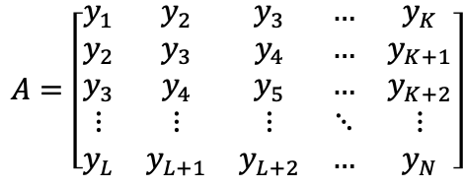
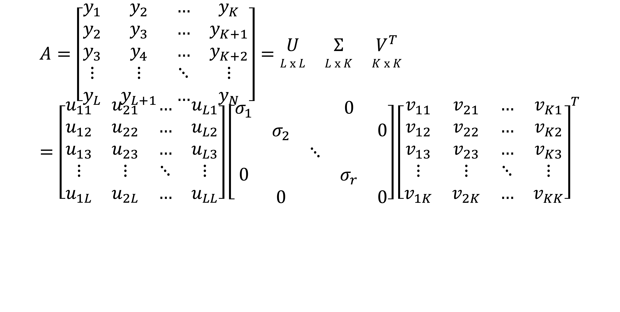
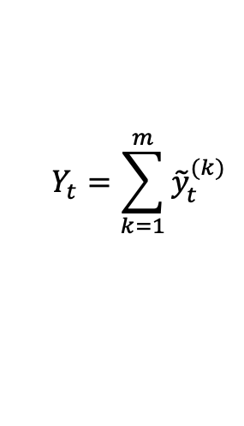
$$A=\left[\begin{matrix}y_{1} & y_{2} & … & y_{K} \\ y_{2} & y_{3} & … & y_{K+1} \\ y_{3} & y_{4} & … & y_{K+2} \\ ⋮ & ⋮ & ⋱ & ⋮ \\ y_{L} & y_{L+1} & … & y_{N}\end{matrix}\right]=\begin{matrix}U & Σ & V^{T} \\ L x L & L x K & K x K\end{matrix}=\left[\begin{matrix}u_{11} & u_{21} & … & u_{L1} \\ u_{12} & u_{22} & … & u_{L2} \\ u_{13} & u_{23} & … & u_{L3} \\ ⋮ & ⋮ & ⋱ & ⋮ \\ u_{1L} & u_{2L} & … & u_{LL}\end{matrix}\right]\left[\begin{matrix}σ_{1} & & & 0 & \\ & σ_{2} & & & 0 \\ & & ⋱ & & \\ 0 & & & σ_{r} & \\ & 0 & & & 0\end{matrix}\right]{\left[\begin{matrix}v_{11} & v_{21} & … & v_{K1} \\ v_{12} & v_{22} & … & v_{K2} \\ v_{13} & v_{23} & … & v_{K3} \\ ⋮ & ⋮ & ⋱ & ⋮ \\ v_{1K} & v_{2K} & … & v_{KK}\end{matrix}\right]}^{T}$$
$$Y_{t}=\sum_{k=1}^{m}{{\tilde{y}}_{t}^{(k)}}$$

